Slide 1

Illegal Trade and Contraband: Global Threats to Economies and Markets El Observatorio del Comercio Ilícito, La Cámara Nacional de Comercio, Servicios y Turismo (CNC)
DAVID M. LUNA
PRESIDENT & CEO
3 October 2018
Santiago de Chile

Slide 2
Bad Actors and Threat Networks
Growing and Emerging Threats to National and Global Security
(Webs of Corruption and Criminality) * Kleptocracy and Complicit Corruption Officials * Criminal Entrepreneurs, Cartels, and Criminal Syndicates, Gangs * Terrorists and Criminal Insurgencies * Virtual Threat, Cyber Bandits, On-Line Illicit Markets, Dark Web
* Dirty Money: Super Fixers, Professional Service Facilitators, Safe Havens

Slide 3
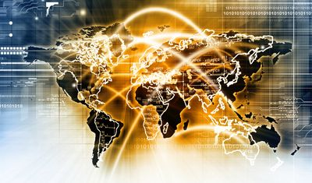
CONVERGENCE

Slide 4
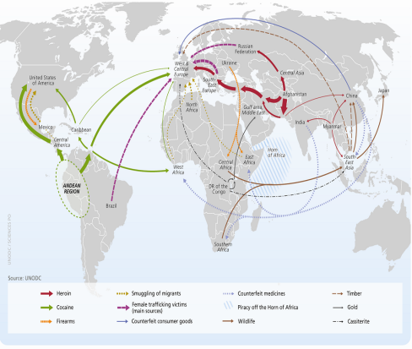
Staggering Size of Illicit Economies/Illicit Markets: +8-15% of World’s GDP ($75.5 trillion, 2016, The World Bank)

Slide 5
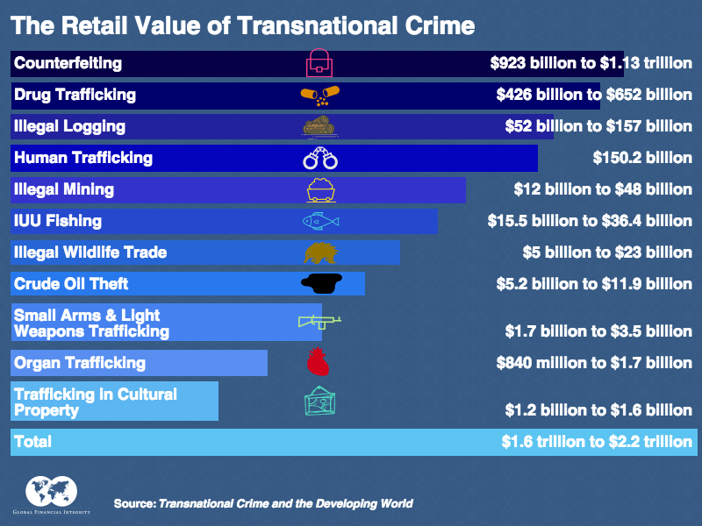
The Global Threat of the Illegal Trade

Slide 6
** Sources: World Economic Forum, World Bank, UNODC , OECD, ILO, GFI
Estimated Global Illegal Trade, Corruption and Illicit Markets
CRIMES | Estimated Annual Dollar Value
Money Laundering | At least $2.6 trillion (between 2 and 5 percent of world GDP)
Transnational Crime | $1.6 trillion to $2.2 trillion
Bribery Narcotics Trafficking | Significant portion of $1 trillion $750 billion to $1 trillion
Counterfeited and Pirated Products | $500 billion to $1 trillion
Environmental Crime (illegal wildlife trade, logging, IUU Fishing, trade in CFCs, and toxic waste) | $91 billion to $258 billion
Human Trafficking/Modern Slavery | Up to $150 billion
Illegal Tobacco | $40 to $50 billion
Illegal Mining | $12 to $48 billion

Slide 7
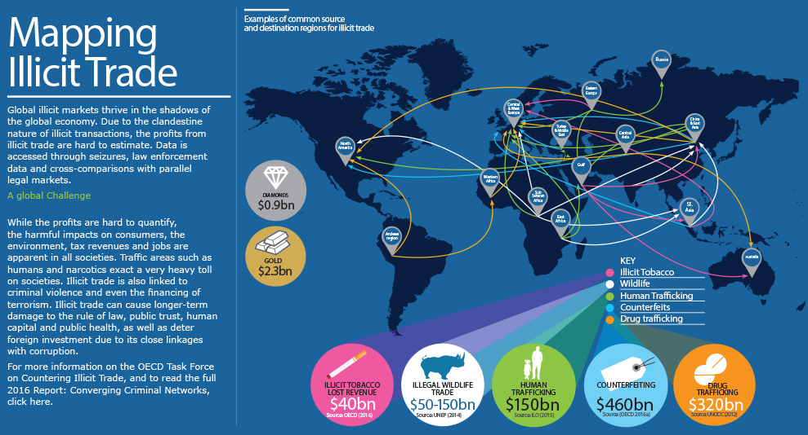
OECD Task Force on Countering Illicit Trade

Slide 8
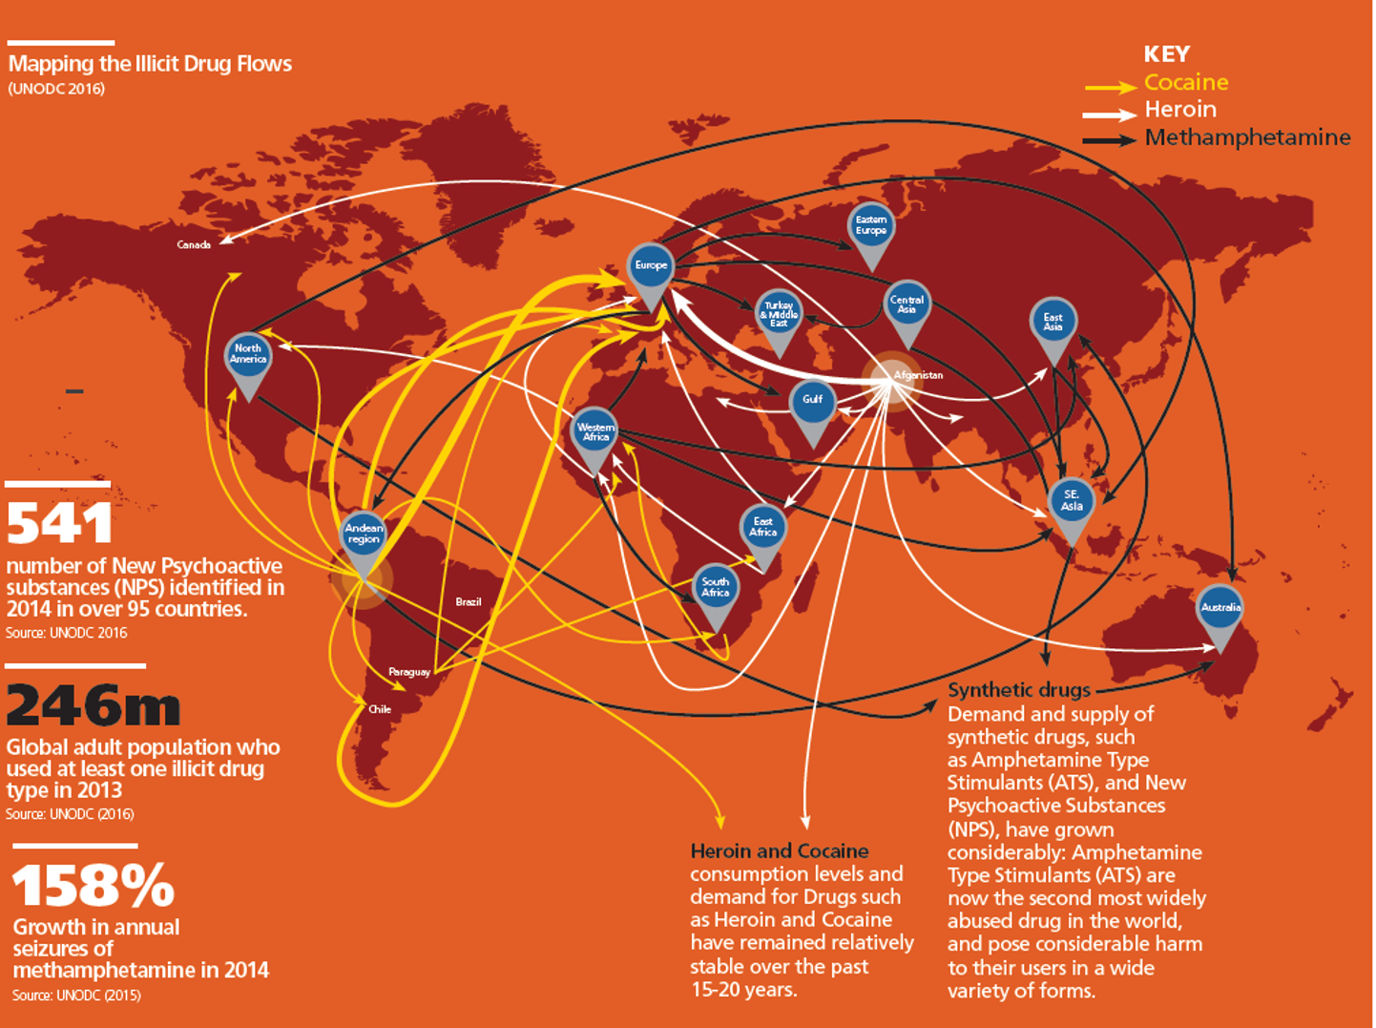
OECD Mapping: Illicit Drugs

Slide 9
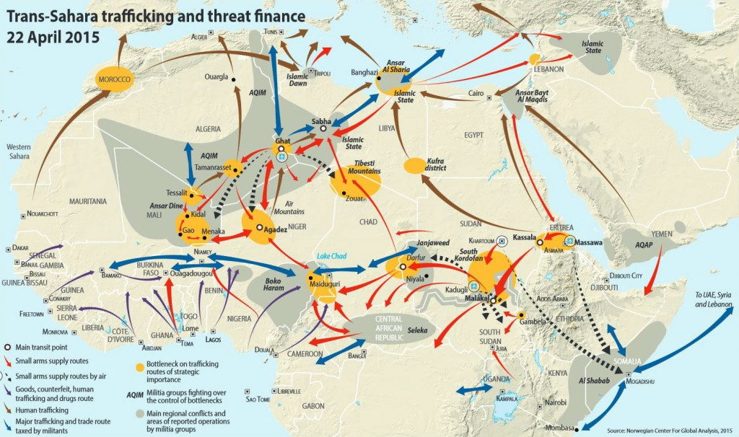
Convergence: Threat Multiplier

Slide 10
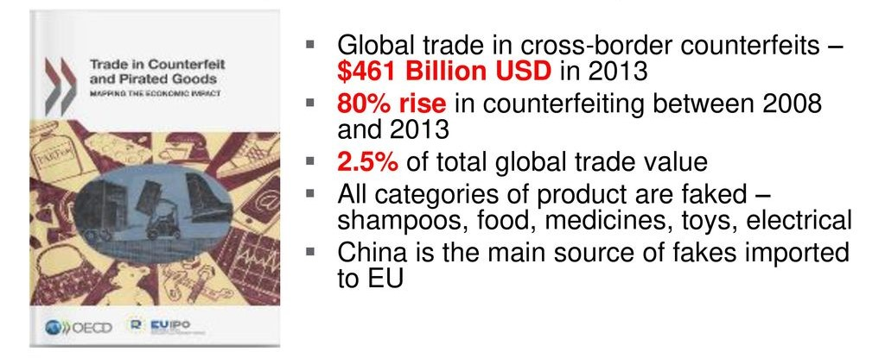
OECD –EUIPO: Charting Counterfeits

Slide 11
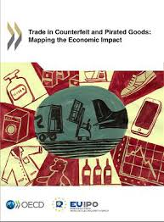
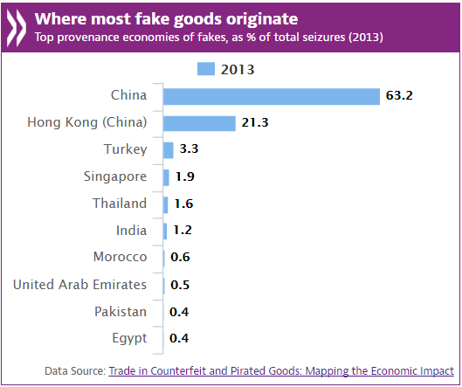
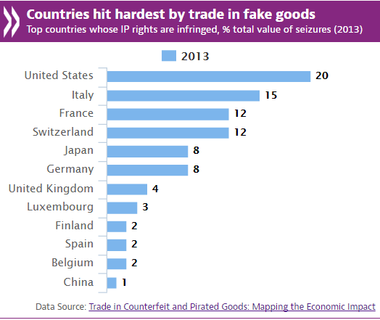
Mapping the Impact: Fakes

Slide 12
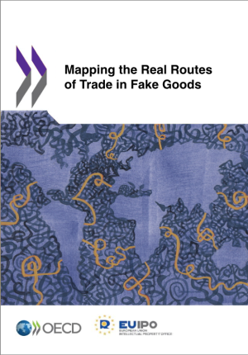
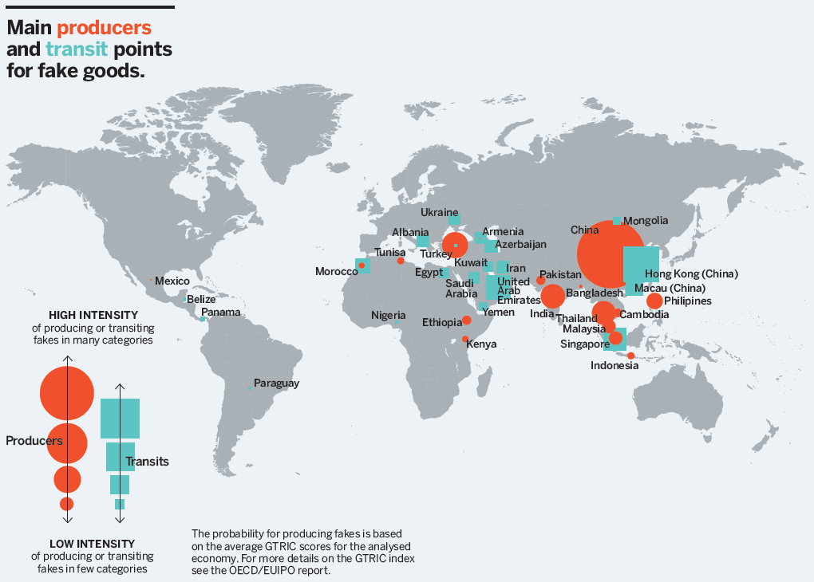
Mapping Illicit Routes: Fakes

Slide 13
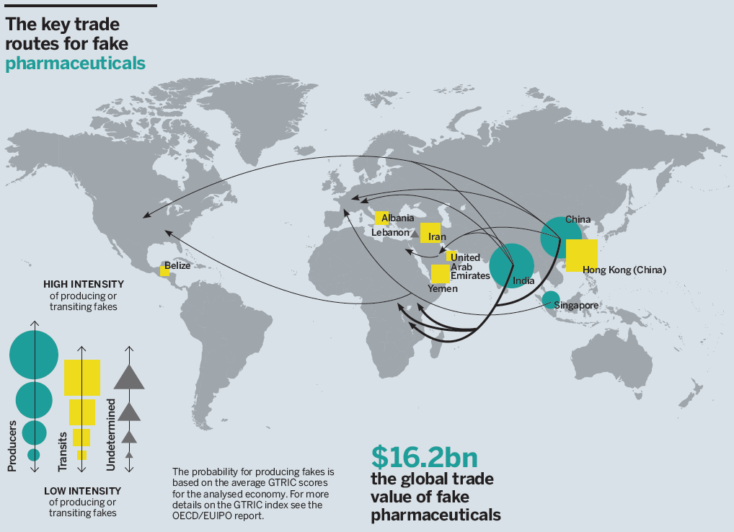
Complex trade routes

Slide 14
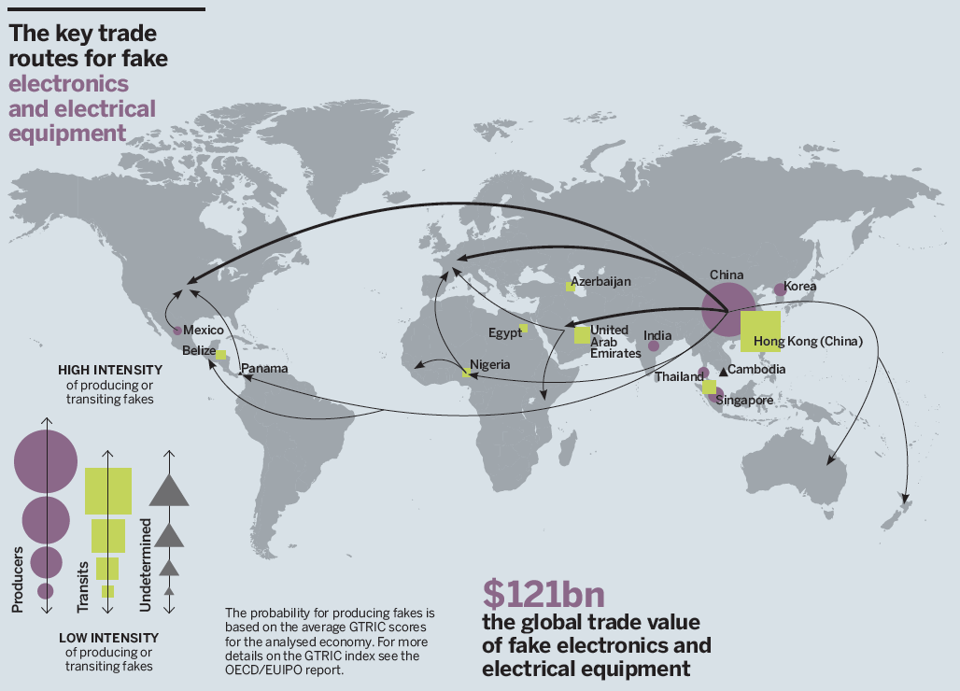
Complex trade routes

Slide 15

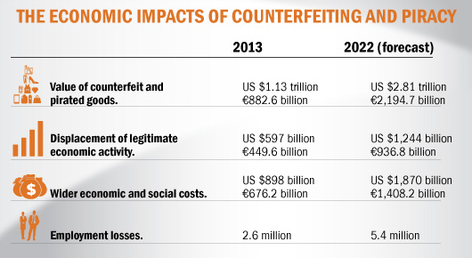
Economic Impacts of Counterfeits and Piracy
Source: The Economic Impacts Of Counterfeiting And Piracy, A Report prepared for BASCAP and INTA by Frontier Economics. All figures reflected here have been provided by Frontier Economics.

Slide 16
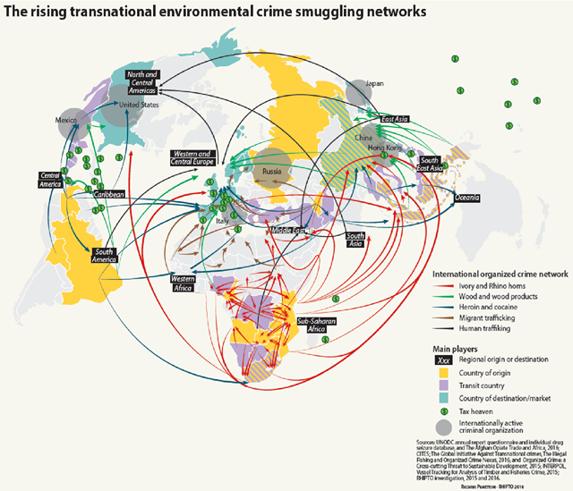
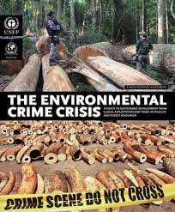
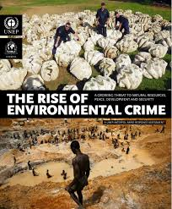
Environmental Crime: $91-$258 billion annually

Slide 17
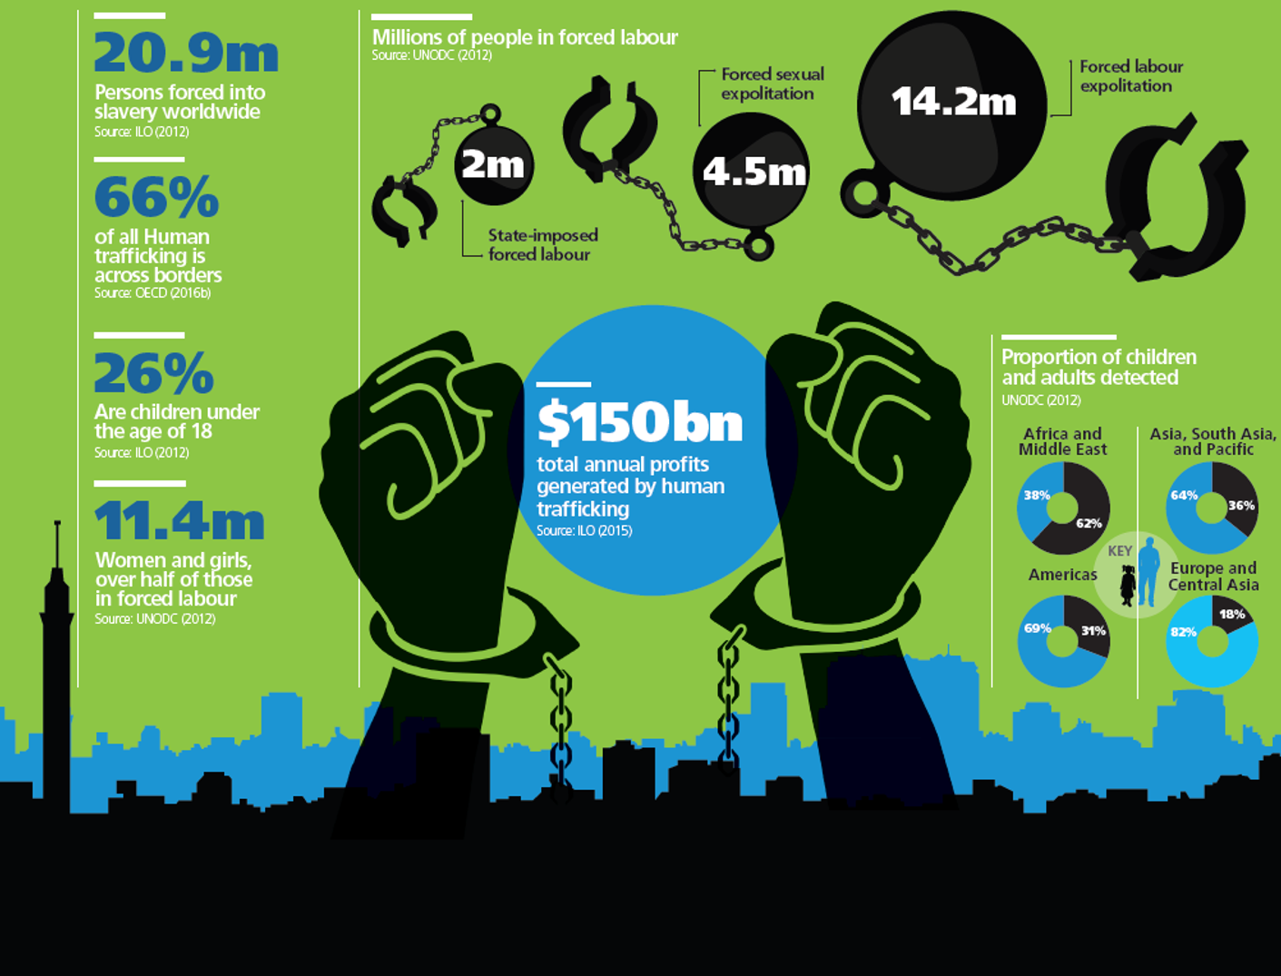
HUMAN TRAFFICKING: $150 BILLION

Slide 18
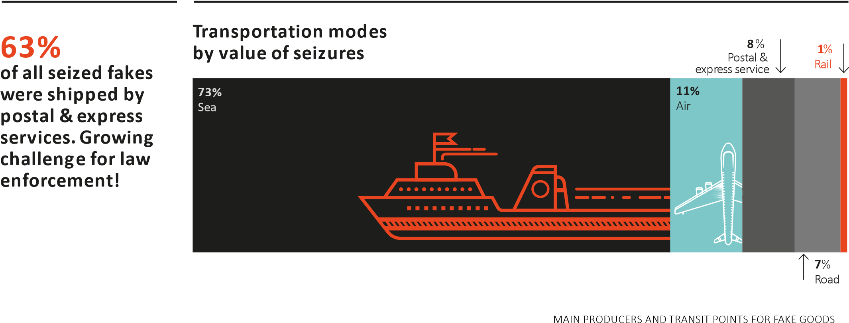
Evidence-Based Data is Critical

Slide 19
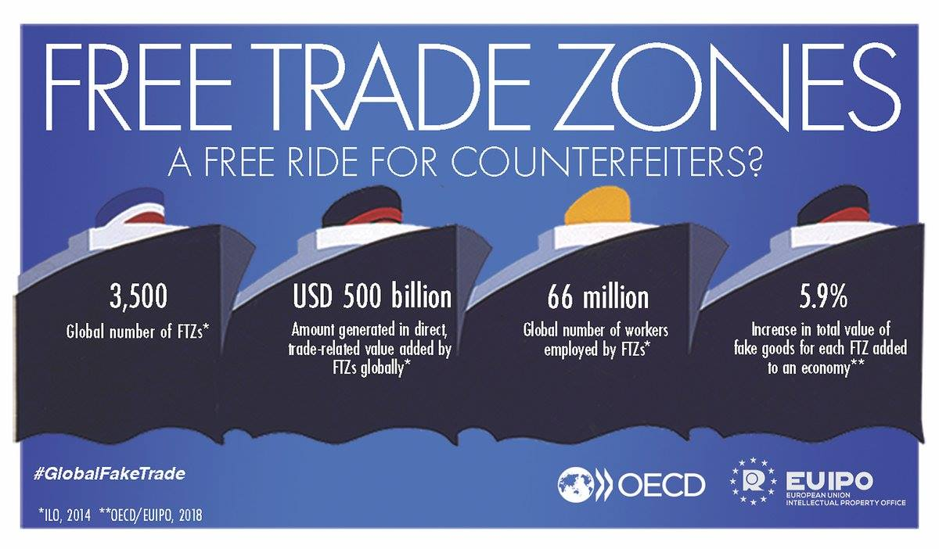
THE VULNERABILITIES OF FTZS

Slide 20
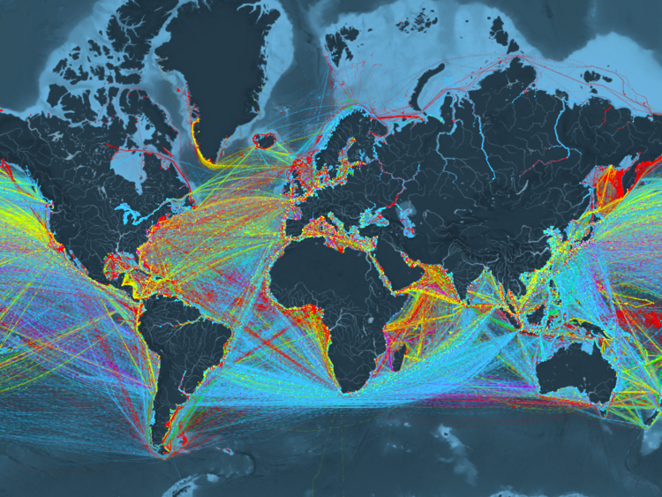
Global Movement of Ships: 2012 [90% of all goods moved across the world by ships] Ship.org: Container (e.g. manufactured goods): yellow; Dry bulk (e.g. coal, aggregates): blue; Tanker (e.g. oil, chemicals): red; Gas bulk (e.g. liquefied natural gas): green; Vehicles (e.g. cars): purple [Kiln Map, Business Insider]

Slide 21


Learn more about LGN: https://lunaglobalnetworks.com/

Slide 22
David M. Luna 1701 Pennsylvania Avenue NW, Ste 200 Washington, DC 20006 202-683-2014 LunaDM@LunaGlobalNetworks.com

