Slide 1

Context Analytics, Inc.
Formerly Social Market Analytics
Context Analytics Pitch deck Extractor (CAPE)
ContextAnalytics-AI.com
ContactUs@ContextAnalytics-AI.com

Slide 2
CA - Predictive Analytics for Unstructured Financial Data
Context Analytics (CA) has been in data warehousing and normalization of unstructured data since 2012
Context Analytics is a Leader in Unstructured Financial Data. CA developed its own proprietary Textual Parsing engine to process any document into machine-readable formats.
Context Analytics is S&P Global’s partner on the U.S. and Global Machine-Readable Filings products (MRF), the first product to provide parsed textual data of company regulatory filings and annual financial reports at the Item, Section, Sub-section, and Notes level across ~4 million documents spanning over 200 countries.

Slide 3
CA - Patented Technology
CA NLP for Sentiment
CAs Patented Natural Language Processing was developed internally. We use a multi-pass phrase evaluation approach combining techniques like stemming and lemmatization. We apply both supervised and unsupervised machine learning on a ten-year training set.
Complex Topic Modeling
To capture information related to Securities, Private Companies, Thematic Investing, or Custom Topics, CA built a Real-Time Machine Learning Topic Model Engine that utilizes collocation to identify inclusions and exclusions in topic models. CA’s NLP uses Synonym identification to capture similar phrases to include in topic models.
CA Parsing Engine
CA’s parsing engine can convert any document to machine readable JSON in seconds. The JSON file is instantly suitable for storage, programmatic analysis and Natural Language Processing.
Source Rating
On social media it’s not just what is being said but who is saying it. CA developed an algorithm to score each account before inclusion in our sentiment metrics. The ability to eliminate spam, bad bots and bad actors produces a more accurate predictive dataset than inclusion of every account on Twitter.

Slide 4
Problem
No central repository for data from potential investments
Unable to query or compare pitchdecks from potential or current investments
Difficult for VC Firms to extract top line metrics quickly from candidates’ financial documents and pitch decks
Manual process to look for data of interest and pull related growth rate data series from original documents
Various document types and formats makes it difficult to navigate
On average VC and PE firms have 4,000 – 5,000 separate pitch decks collected from potential investments
They face the challenge of data extraction and organization from various document types and formats. Comparison across potential investments is difficult

Slide 5
CAPE Value Proposition
Context Analytics Insight Extractor speeds up analysis and ultimately decision making
Centralized – standard format allows rapid ingestion into databases providing the ability to query
Fast - full library of 1000s of documents can be ready in a few hours
Versatile and Thorough – extracts data from hundreds of formats including hidden rows/ columns, forecast vs actual financials, & multipliers (EurMM, 1000s USD, etc)
Enhanced Decision-Making – allows for deeper statistical analysis and more allocated time for analysis
User-Friendly – centralized output is available in Excel, Snowflake, CSV, or any other custom formats

Slide 6
CAPE Key Features
Convert data into various formats. JSON, EXCEL, CSV (7-8)
Item identification (9-10)
Interpolation (11)
Estimate vs Actual Identification (12)

Slide 7
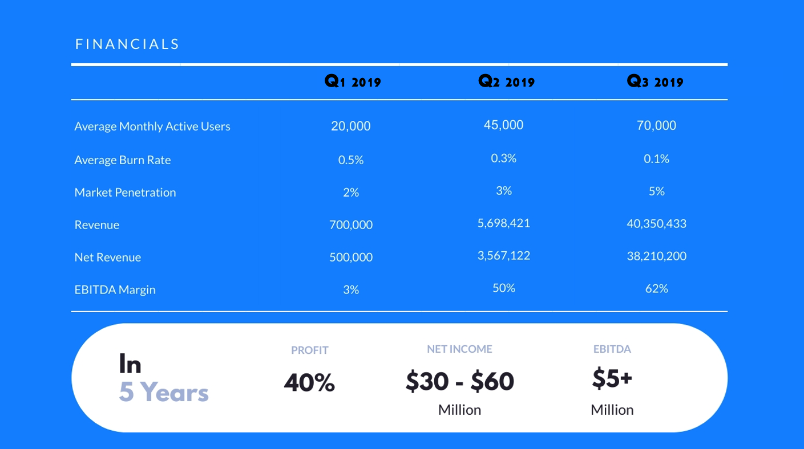
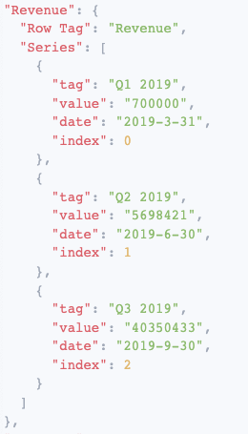
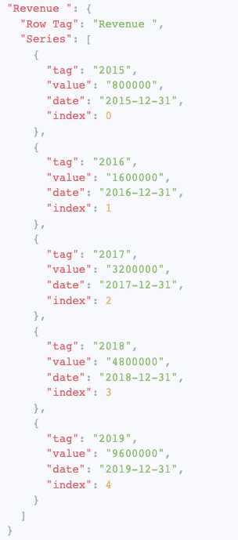
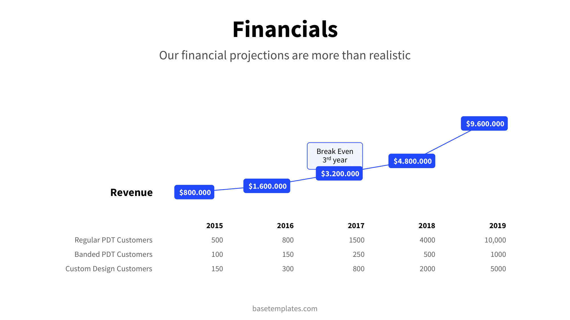
Conversion to JSON
The Context Analytics Insight Extractor uses the same parsing engine that processes millions of company regulatory filings and assorted financial reports to extract financial metrics and convert them into a JSON format, allowing quick search and plotting capabilities.

Slide 8
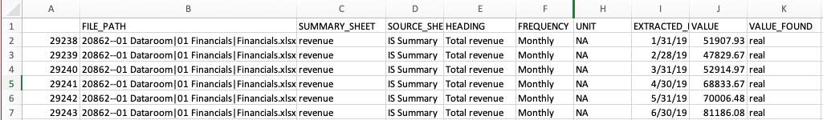
Multiple Centralized Format Options
Pivoted and unpivoted data
  Pivoted data for excel and manual analysis (Top)
  Unpivoted data for advanced data analysis and visualizations (Bottom)

Slide 9
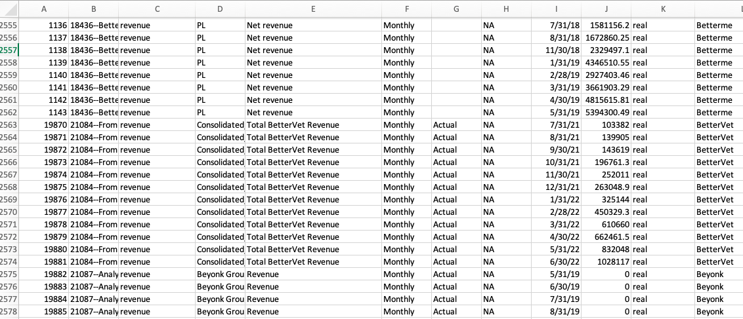
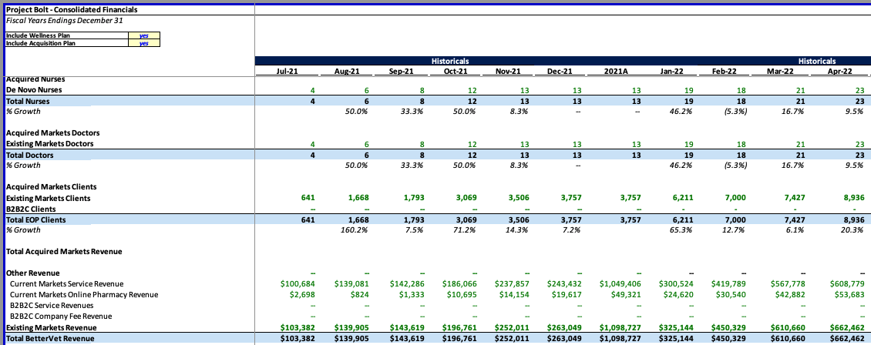
Top Line Identification
Streamlines the evaluation process
Filters out irrelevant headings, documents, and files, programmatically identifying a top-line series associated with each company
Option for sharing all extracted data with no filtering
Can be expanded for other items: Cost, NI, Employees…

Slide 10
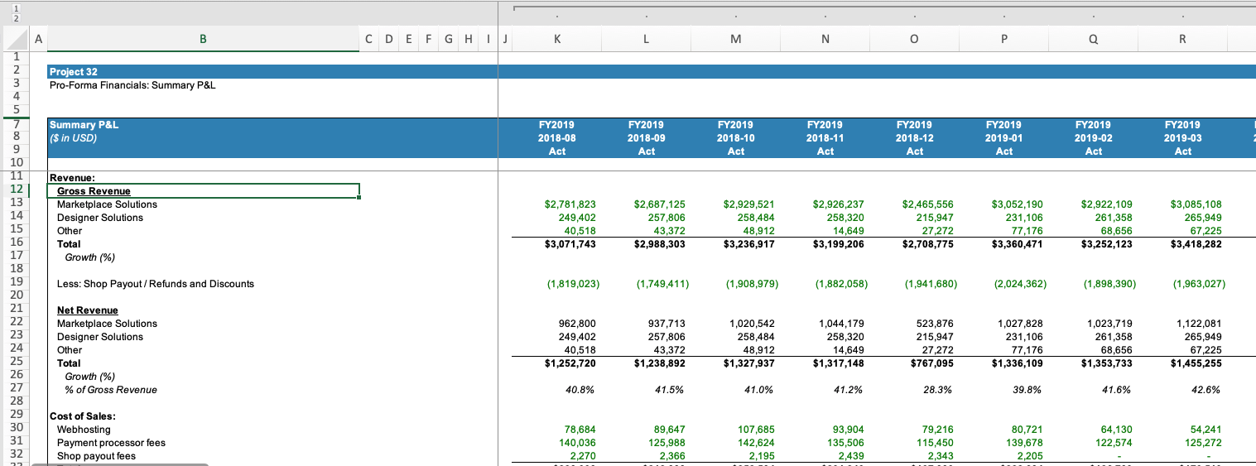
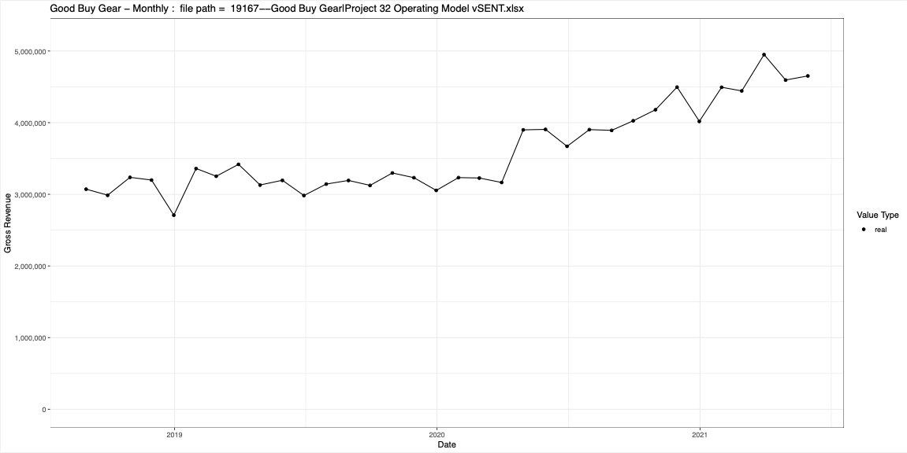
Chart Example
Picks up Gross Revenue, Net Revenue, and % of Gross Revenue
Correctly identifies Gross Revenue as Top-Line

Slide 11
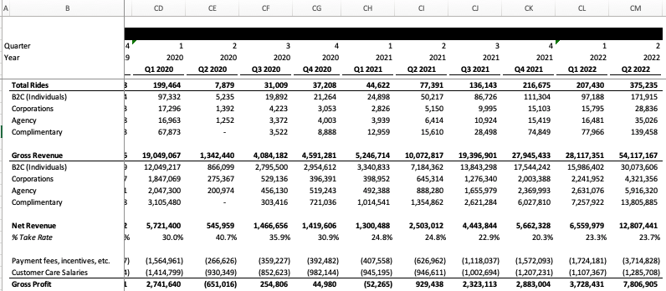
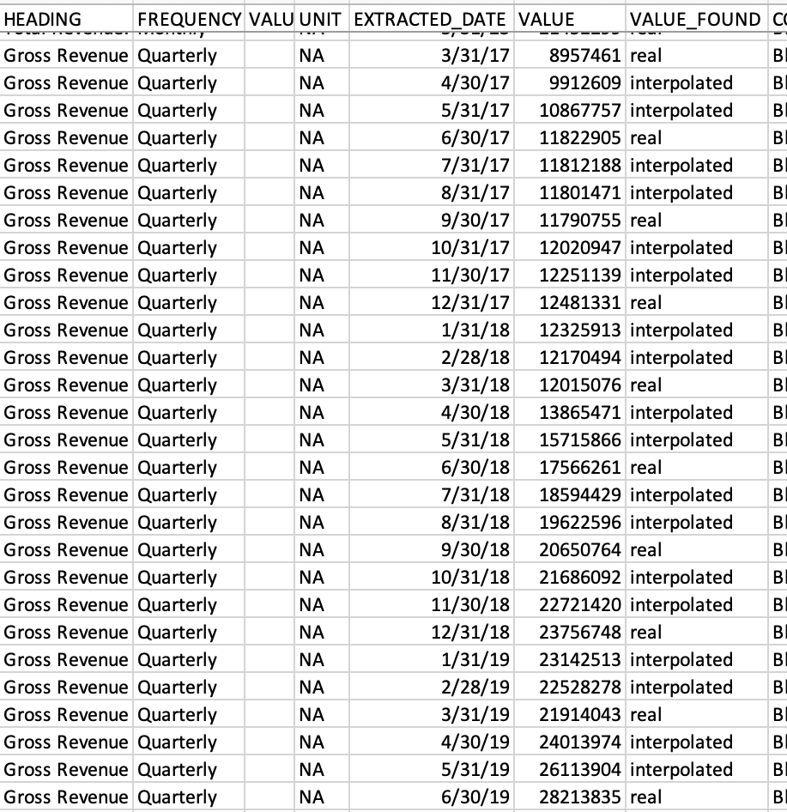
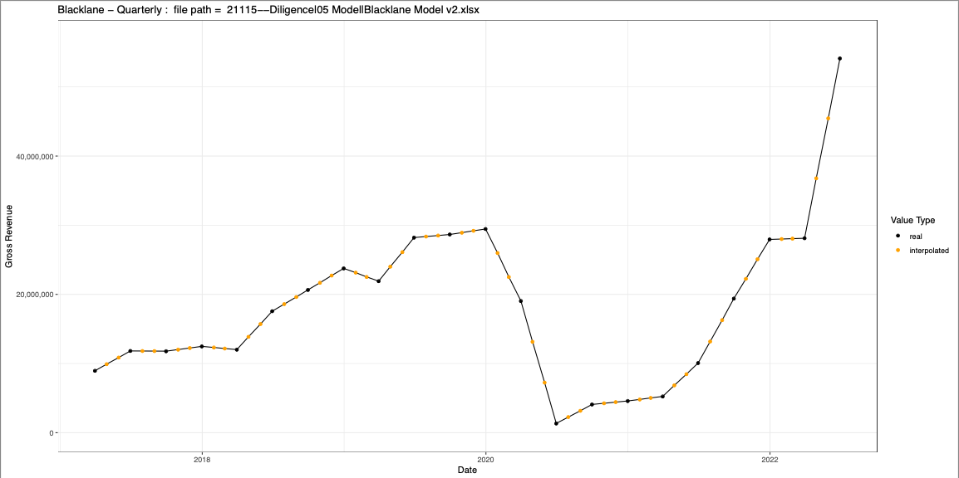
Interpolation
Companies report in different time intervals: Monthly, Quarterly, Yearly
CAPE Interpolates data to allow comparison across companies with different intervals of reporting

Slide 12
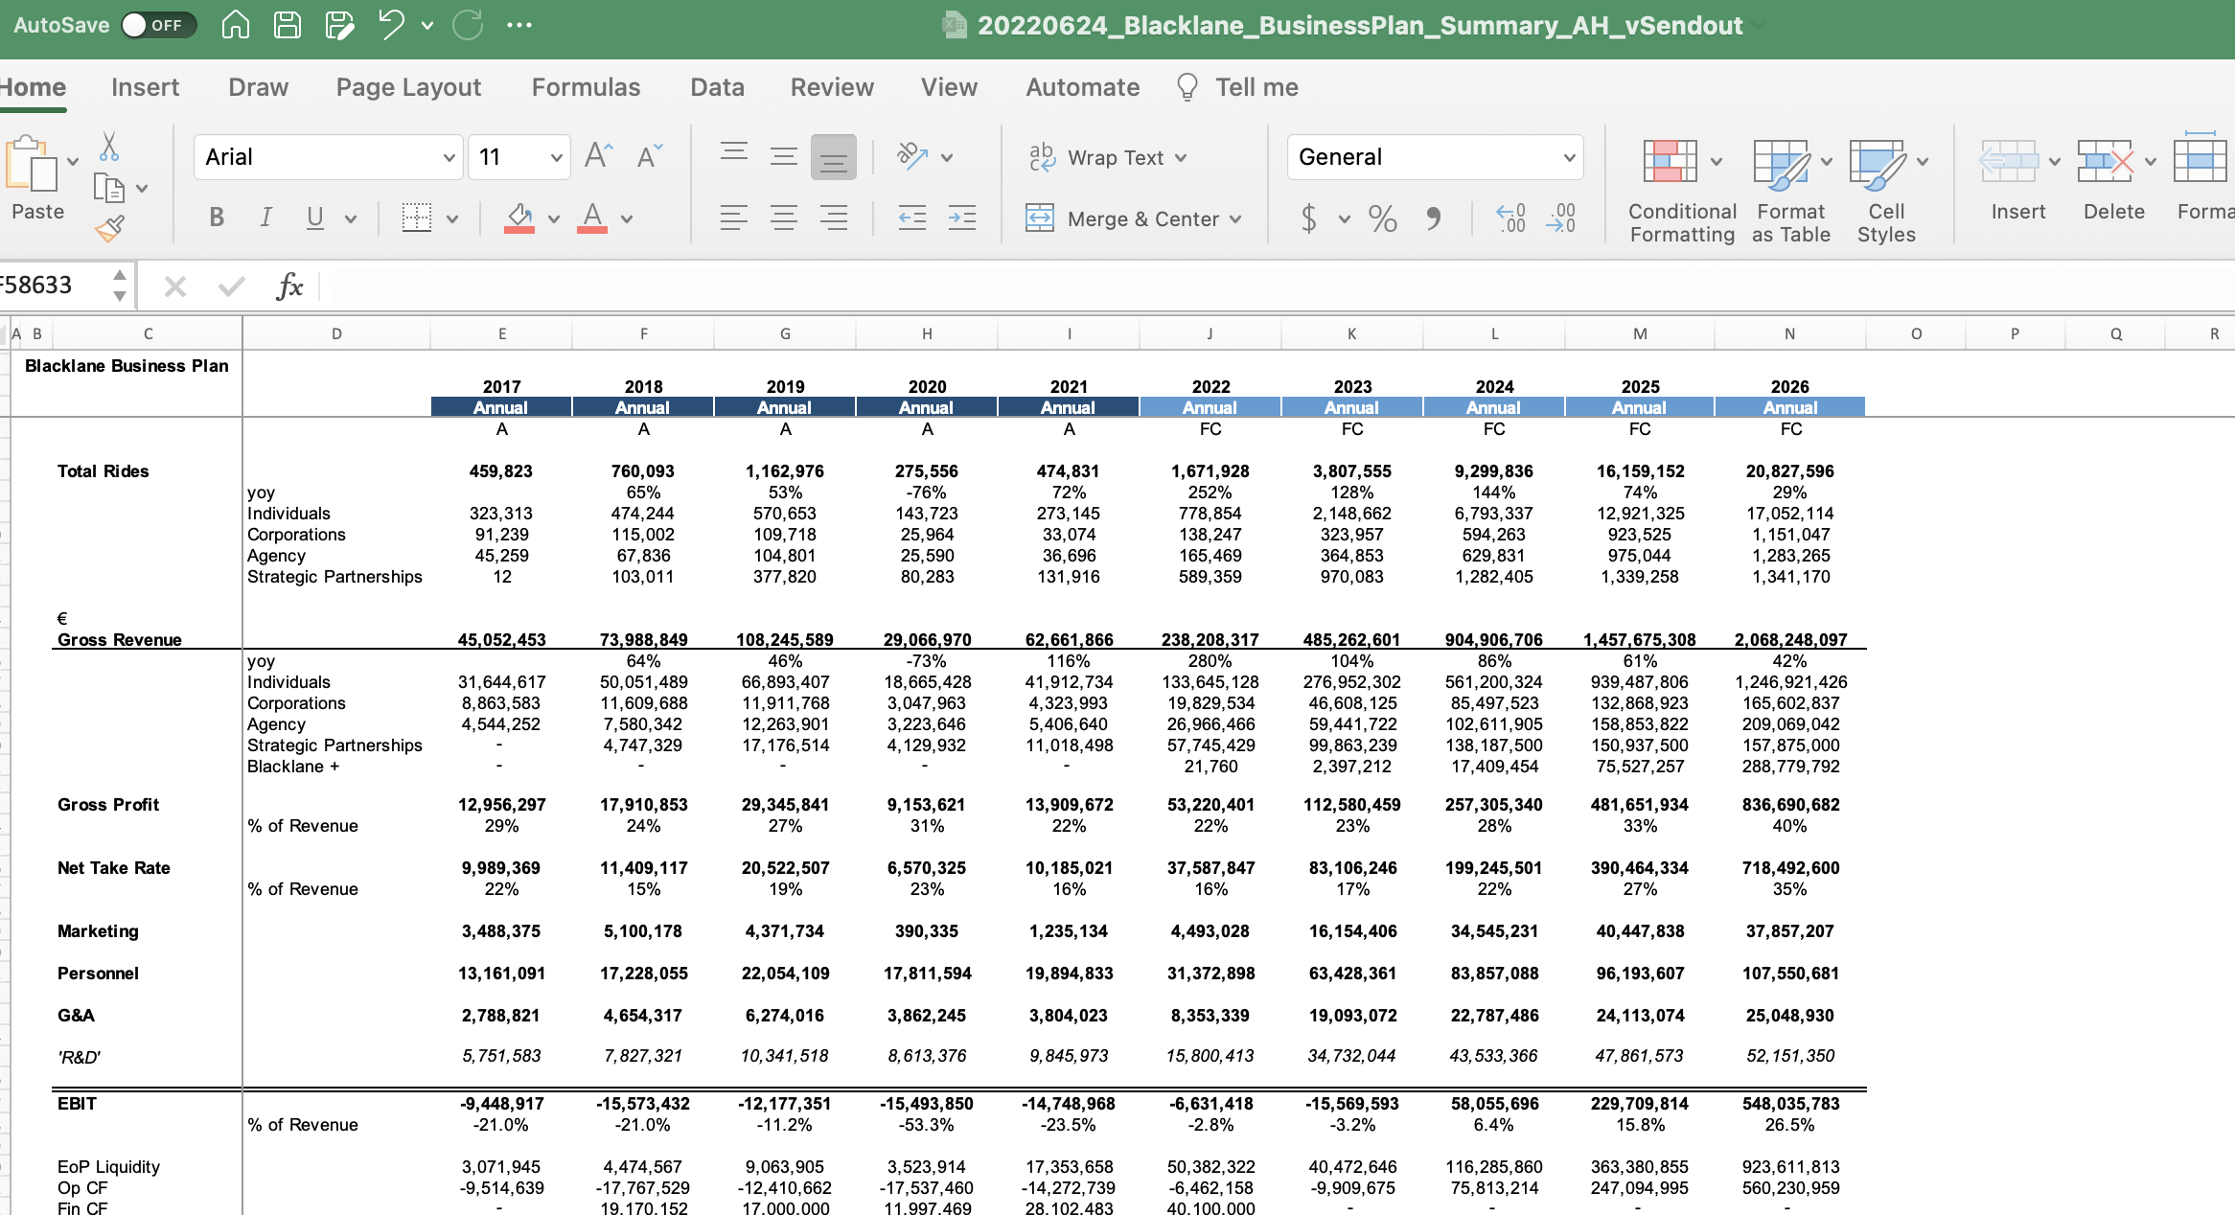
Estimated vs Actual Identification
Many companies report historic and/ or forecasted financials in their pitch book
CAPE identifies when numbers are historic or forecasted for proper evaluation

Slide 13
Summary
CAPE turns financial pitch decks into machine-readable data
Centralize your pitchdeck data today
Questions? Next Steps?
ContextAnalytics-AI.com
ContactUs@ContextAnalytics-AI.com

