Slide 1
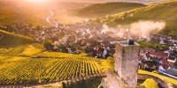

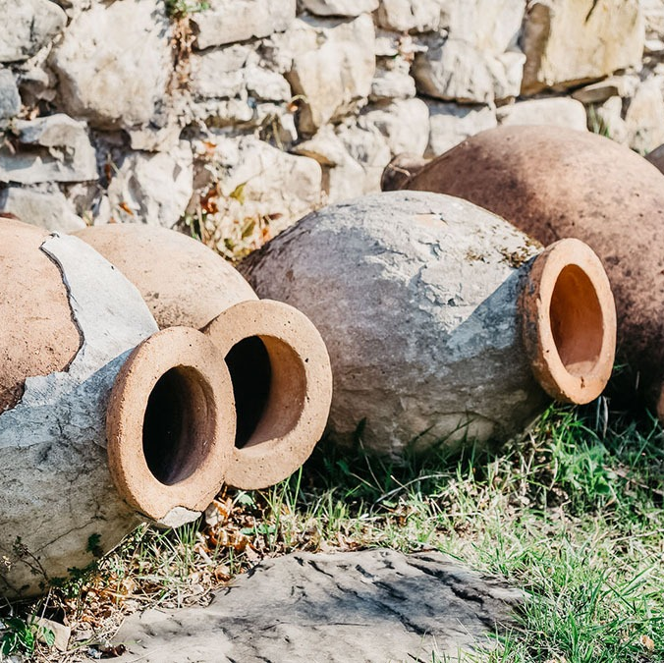



Capabilities
Specializing in wines, spirits, travel, and food, Deussen is particularly known for fast-start results and iron-clad guarantees.
NEW YORK | CHICAGO | MIAMI | SAN FRANCISCO

Slide 2
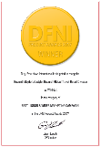
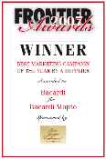
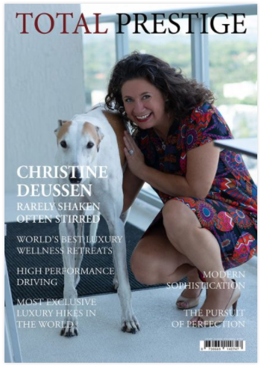
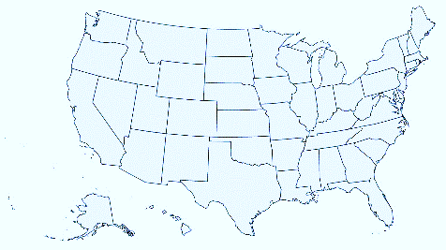
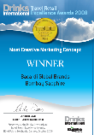
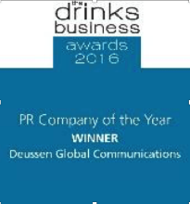
About Deussen
Est. 2002 and voted “Global PR Agency of the Year” by The Drinks Business (UK) in 2016 among many other accolades, Deussen has deep roots in trade and lifestyle media as well as among key influencers, allowing the company to deliver meaningful results quickly. Staff are based in New York, Chicago, Miami, and San Francisco.

Slide 3
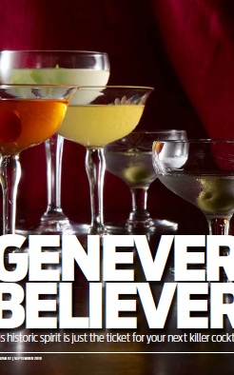
Expertise leads to efficiency; efficiency leads to quick, meaningful success
In domestic wine & spirits business since 1993, and global duty free since 2004
Experience spans PR, communications, marketing, bartending, imports, distribution, and retail
Deep knowledge of industry laws with resources across all disciplines (legal, design, promotions, etc.)
Media relationships nurtured for 25+ years by agency president, as well as continued outreach to new writers and influencers
Trade relationships with GMs, F&Bs, restaurant group owners, retailers, educators, promoters, and industry KOLs
Constantly evolving influencer database
Knowledge of which trade shows, competitions, ratings, etc., matter (and which don’t)
Fast-start programming & results
Native French, Spanish, and Mandarin speakers on staff
7-page print feature in Wine Enthusiast magazine;
total time from pitch to placement was 1 year

Slide 4
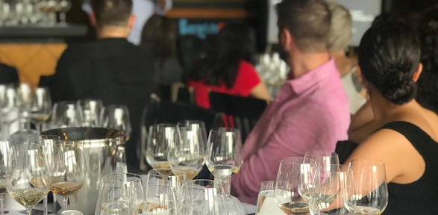

A
LOGICAL APPROACH
Seminar in Boston for the wines of the country of Georgia, attended by more than 40 media, trade, educators, & influencers
STRATEGY: Your goals are our goals
TRADE: Let’s move some boxes
LIFESTYLE: Image is everything
Deussen PR campaigns exist to brand and corporate goals. It is not just PR for PR’s sake: we are here to move the needle on awareness and sales.
Samplings, ratings, award submissions, media quotes, trade shows, hospitality schools, distributor launches, trade newsletters, winemaker visits
Media relations, corporate and culinary partnerships, event management, market tours, press visits, influencer marketing, social media

Slide 5













/ References Always Available /
Relevant Governmental Experience: Decades of Happy Customers

Slide 6

Most Important: Meaningful Results
Not just PR for PR’s sake
We are your brand partner, here to work for and with you to use PR tactics to help achieve the brand and corporate goals; when you succeed, we succeed; when you grow, we grow
Deussen PR campaigns
  Grow image
  Pull volume
  Amplify success
  Support in areas of weakness
  Reach millions of target consumers at once
  Generate third-party endorsements that impress
How to measure impact
  Creation of useful sales tools: B2B and POS
  Feedback from the trade
  Click throughs
  Social posts and re-posts of earned media content
  Pre- and post surveys: internal or third-party
  Number of stories
  Number of impressions
  CPM (cost per thousand impressions)
  ROI

Slide 7
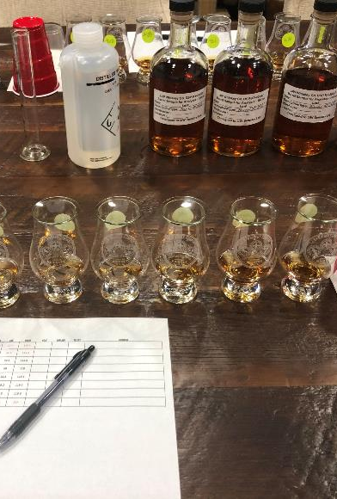
General Ways of Working
READY
Full briefing by brand team so that the PR campaign reflects, supports, leverages, and amplifies the qualitative and quantitative brand objectives
A mini “listening tour” with sales is often powerful; allows their needs to be balanced against brand objectives in order to meet both
E-introduction to all agency partners so we can pull together, work most efficiently, and build a consistent global brand image
Ongoing monitoring and analysis of trends, angles, competitive activity, etc.; constant stream of ideation for client
Ideally a visit to the source; we are happy to fly economy class
Develop PR plan; gain internal approvals; bring to outside bodies for input; finalize
Ongoing communication to facilitate cross-pollination, course-correct quickly if needed, adjust to world events, etc.

Slide 8
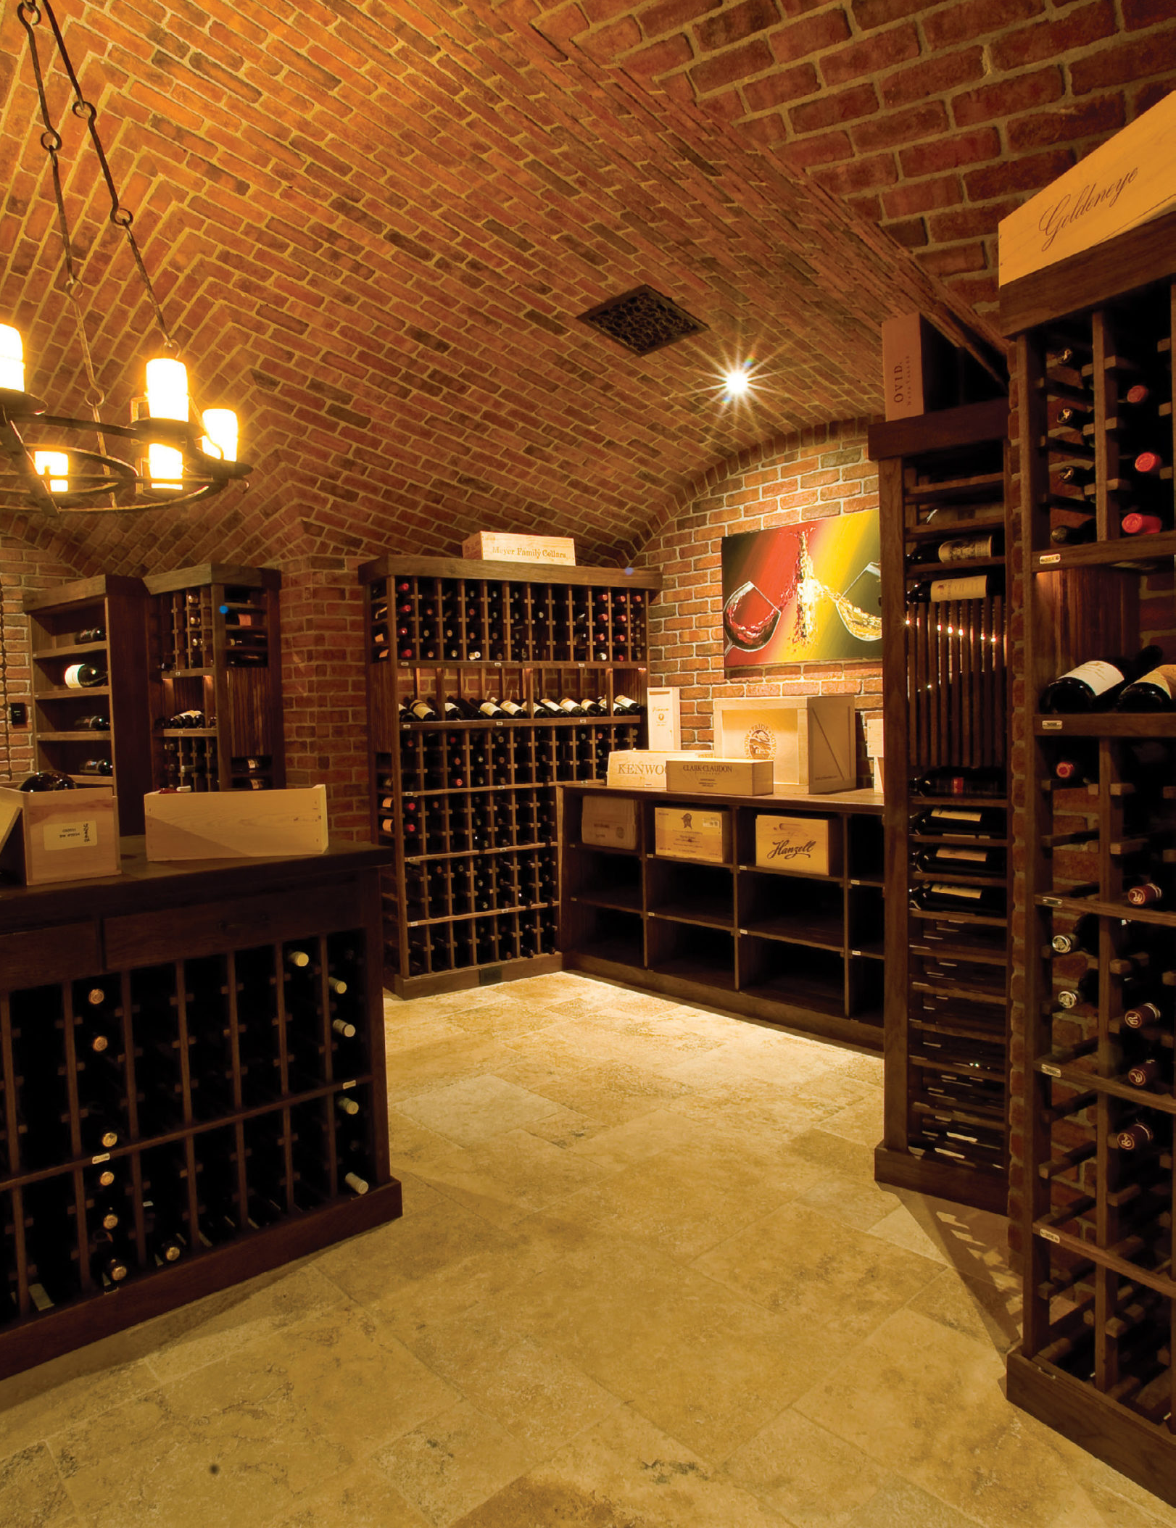
General Ways of Working
AIM
Create or confirm key messages
Adapt or create press materials as needed (bios, tech sheets, history, category info., etc.)
Stock image bank (still & video); request anything further than may be needed
Host internal, competitive blind tasting
Review editorial calendars in order to pitch inclusion in round-up stories
Build custom media list for each segment (channel, geographic, etc.)
Assess ratings/competition opportunities and advise accordingly

Slide 9

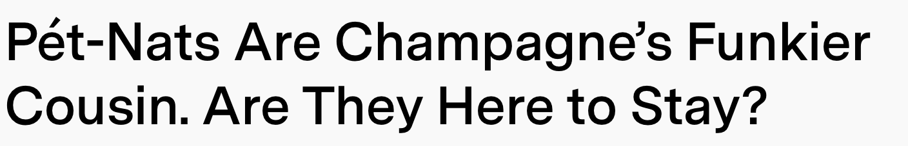




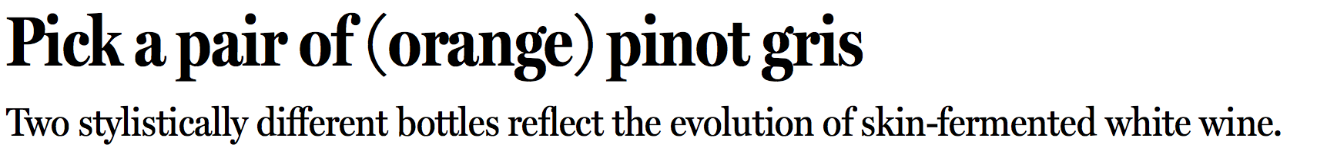
General Ways of Working
FIRE
Constant stream of strategic communication to all constituencies
  Internal: client contacts; and, as directed partner agencies, winemakers/distillers, key distributor salespersons, etc.
  External: BevAlc community, influencers, trade & consumer media, vendors as appropriate, consumer-facing partners, consumers if warranted, etc.
Mechanisms include pitches, press releases, statements, Q&As, interview prep sheets, media dossiers, crisis planning and communications, etc.
Circulate collages of media results to support sales efforts
Sample Deussen client headlines, Nov. 2021

Slide 10
General Ways of Working
EWS
Kristen Bieler, SevenFifty, “guest” piece
Samples shipped; dossier written & supplied
Did it go OK?
Dick Rosano, Freelance, Whisky Advocate
Interview set & calendered for Thurs., Oct. 7th
Dossier written and supplied
Press materials and samples shipped
Zak Kostro
Interview set & calendered for Weds., Oct 13th
Press materials sent
Dossier drafted
Next up: samples to be shipped
Nycci Nellis, Foodie & The Beast
Bruce & Jake on Sat., Oct. 23rd
Working on background materials
Will work in surrounding appointments
Pitched second wave of DC outlets
  Julia Coney, Vinepair
  Kelly Magyarics, Liquor.com
  Tom Siestema, The Washington Post
  Natalie Compton, The Washington Post
  Joe Yonan, The Washington Post
  Tim Carman, The Washington Post
  Matt Glassman, WRC2-TC
  Scott Grenberg, WTOP Radio
  Kayleigh Kulp, The Daily Beast
  Laura Wainman, WUSA-TV
ASSESS
Coverage tracker maintained as Google Sheet, so client can access any time
  At minimum: date, outlet, author, title, link, syndications
  Other possibilities: key message cut-through, success of image replication, weight of article, etc.
  Competitive brands can also be tracked
Status calls against written agendas
  Anyone can join
PPTs of key press results
Quarterly reviews: What is working? What is not? What can be changed? How are deliverables coming along (qualitative, quantitative, CPM, ROI)? What has changed within our brands’ world? What has changed in the world around us?
Administration: VERY FAMILIAR with EU book-keeping requirements
Sample except of a bi-weekly call agenda

Slide 11
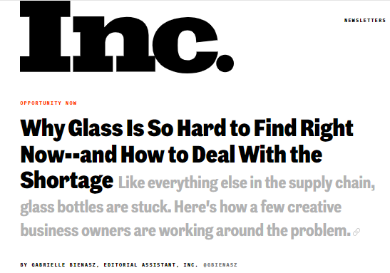
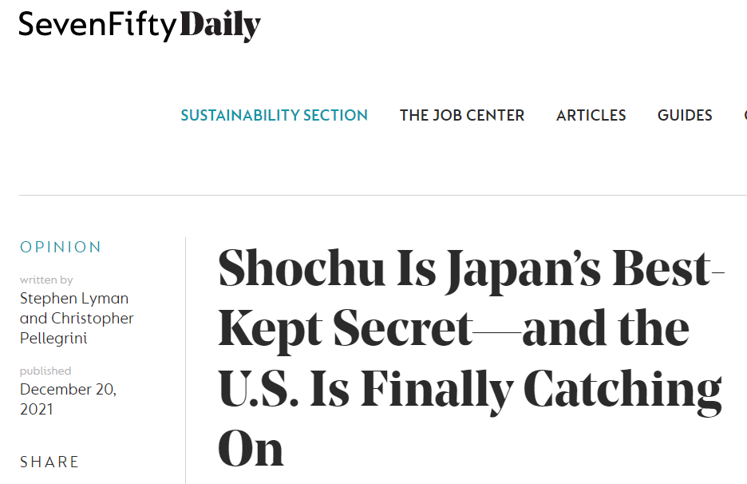
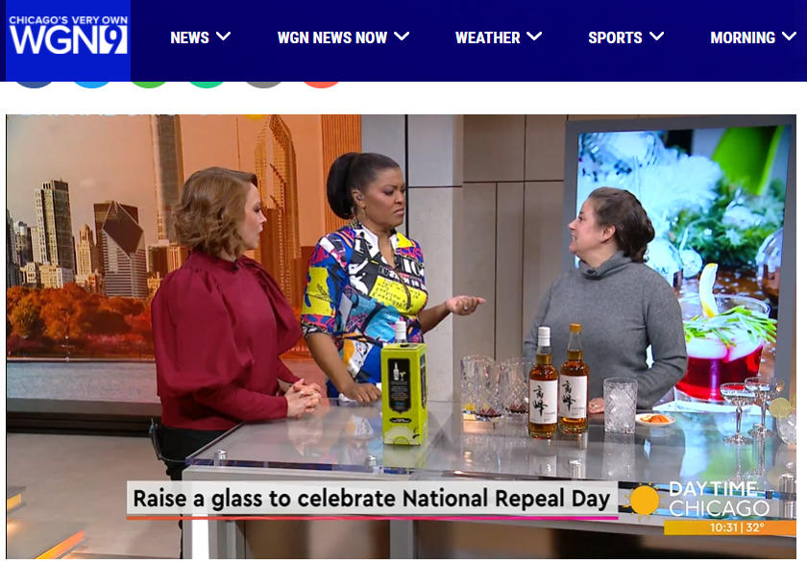
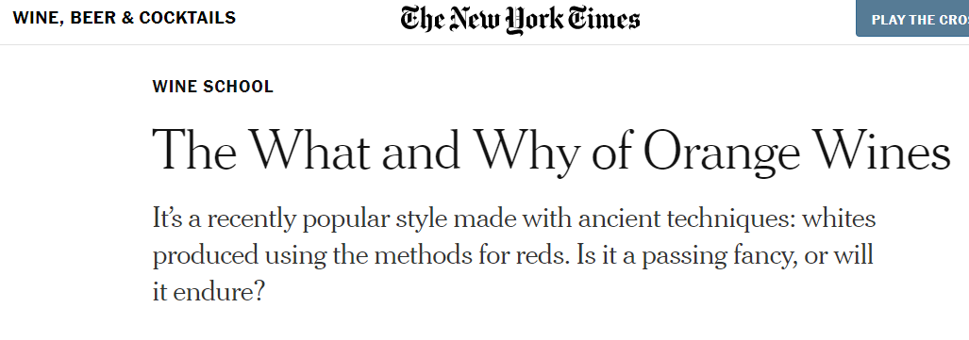
Media Relations
OUR DAILY MISSION
Trade
  An important basic
  Round-ups matter
  About 50 writers to regularly court
  Solid system for breaking exclusives
Consumer
  It used to be about 100 writers to routinely court, then 1000, and now it seems almost limitless
    There are the core, most important writers, but there are ALWAYS new relationships to develop
Sample client headlines, Dec. 2021
Cheddar TV

Slide 12

KOL, Influencer, and Community Relations
The established leaders
The up-and-coming leaders
Special interest groups
Trade/Consumer Shows
Key market expertise, coupled with constant curiosity and desire to learn

Slide 13
Deussen was recommended to us by our Ice Cider partner, Domaine Pinnacle, at a time when we were unhappy with the performance of the Agency we had been using.
We started working with Deussen in 2007. Christine was very involved in the initial brief and gathering brand knowledge. I clearly remember the pleasure I had in sharing such knowledge with her, as she is one of the very few people I had dealt with who was more interested in learning about our brand DNA rather than telling us what that brand DNA should be. As the result, the very first plan proposed by Deussen was exactly in line with what we had hoped for, and got implemented with very few tweaks.
Unfortunately, our distributor was sold out just a few months later, and we had to stop the program just as it was getting to full speed. At that stage, I was very impressed by how thorough Deussen was in making sure the PR program was wound down properly. I had never worked with an agency that kept working just as diligently when facing such situation as when they were looking at a multi-year contract.
We kept using Deussen for specific projects (in the US and outside) throughout 2008 and 2009, as we rebuilt access to the US market. By 2010, we started working together again on full yearly programs, stepping up the content and reach in increments. Today, we are extremely happy with the results Deussen is providing.
I went through this lengthy story as a way to illustrate my recommendation of Deussen as follows:
- They are an incredibly dedicated, loyal, and thorough team
- They care about their clients, and have a passion for the brands they represent. In fact, I found them to be amazing ambassadors for our brand
- They deliver on-time, on budget, and almost always above expectation
- They understand the brand well, and tailor PR programs that are very well suited to our objectives
They definitely have a long-term approach, with both the brands they represent, and the journalists and trendsetters in their network. I had the chance to see personally how those people truly respect Christine and her team.
So, In summary, Deussen Global is the best agency I ever worked with. They over-deliver, and care about the results for the brands as much as we do ourselves.
I hope this will help you in making your decision on which agency to retain.
Cheers, Cyril Camus.
Client Accolade:
CAMUS Cognac
Largest family-owned Cognac House
First hired for global duty free, then domestic US, then for coffee line extension
Deussen Global is the best agency I ever worked with. They over-deliver, and care about the results for the brands as much as we do ourselves.
- Cyril Camus, CAMUS Cognac

Slide 14
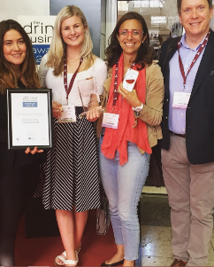
Deussen Team
The Best Solution
A one-stop shop for reaching media and KOL
Able to deliver national and regional results
Innovative, effective, smart media interface resulting in media coverage that makes clients look far bigger than they are
Deep industry understanding, with ability to tailor PR programming and coverage to drive image, volume, or both
Adept at balancing cultural norms
Cost per thousand impressions (CPM) measurements regularly blow away industry standards (benchmarked vs. Diageo)
Frequent, in-depth, transparent, quantitative reporting

Slide 15

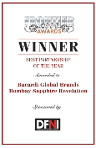
We are grateful that you are interested in our company and services.
Please be in touch if we could share our advice or experience with you.
Christine Deussen, President
cdeussen@deussenglobal.com
+1-917-545-1459
DEUSSEN GLOBAL

